Slide 1
Top Five Books for Learning Python
in 2023
Behzad Samadi

Slide 2
What Are the Top 5 Books for Learning Python?
“Python Crash Course” by Eric Matthes
“Fluent Python” by Luciano Ramalho
“Python Tricks: A Buffet of Awesome Python Features” by Dan Bader
“Effective Python: 59 Specific Ways to Write Better Python” by Brett Slatkin
“Python Cookbook” by David Beazley and Brian K. Jones.

Slide 3
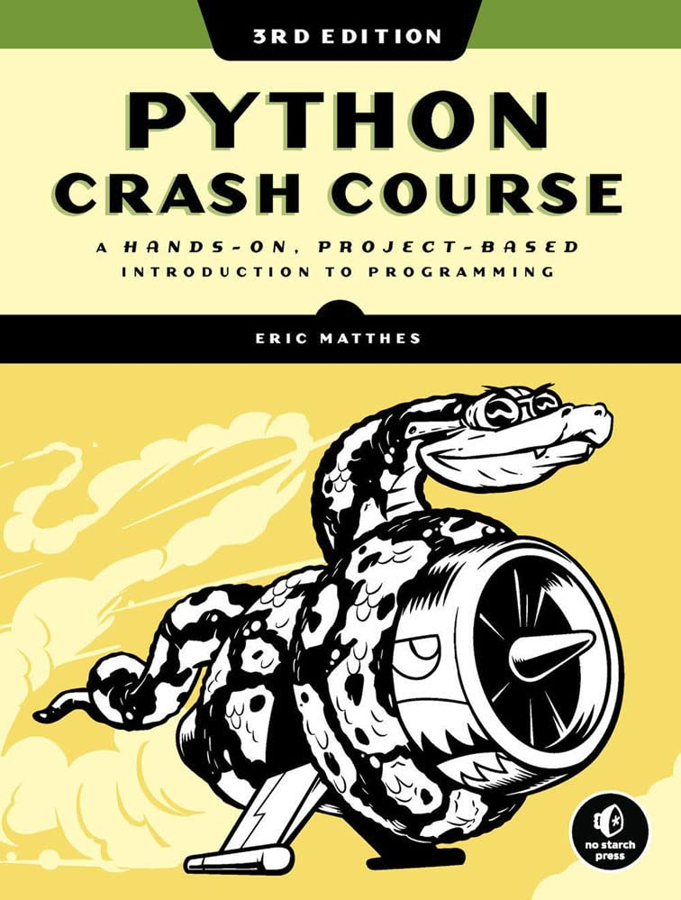
Python Crash Course, Eric Matthes
Python Crash Course

Slide 4
Python Crash Course, Eric Matthes
A good understanding of the basics of Python programming
Hands-on experience with building simple programs and projects
The ability to work with different types of data in Python
Familiarity with common libraries and modules in Python
Basic knowledge of object-oriented programming and using classes in Python
Understanding of how to debug and troubleshoot Python code

Slide 5
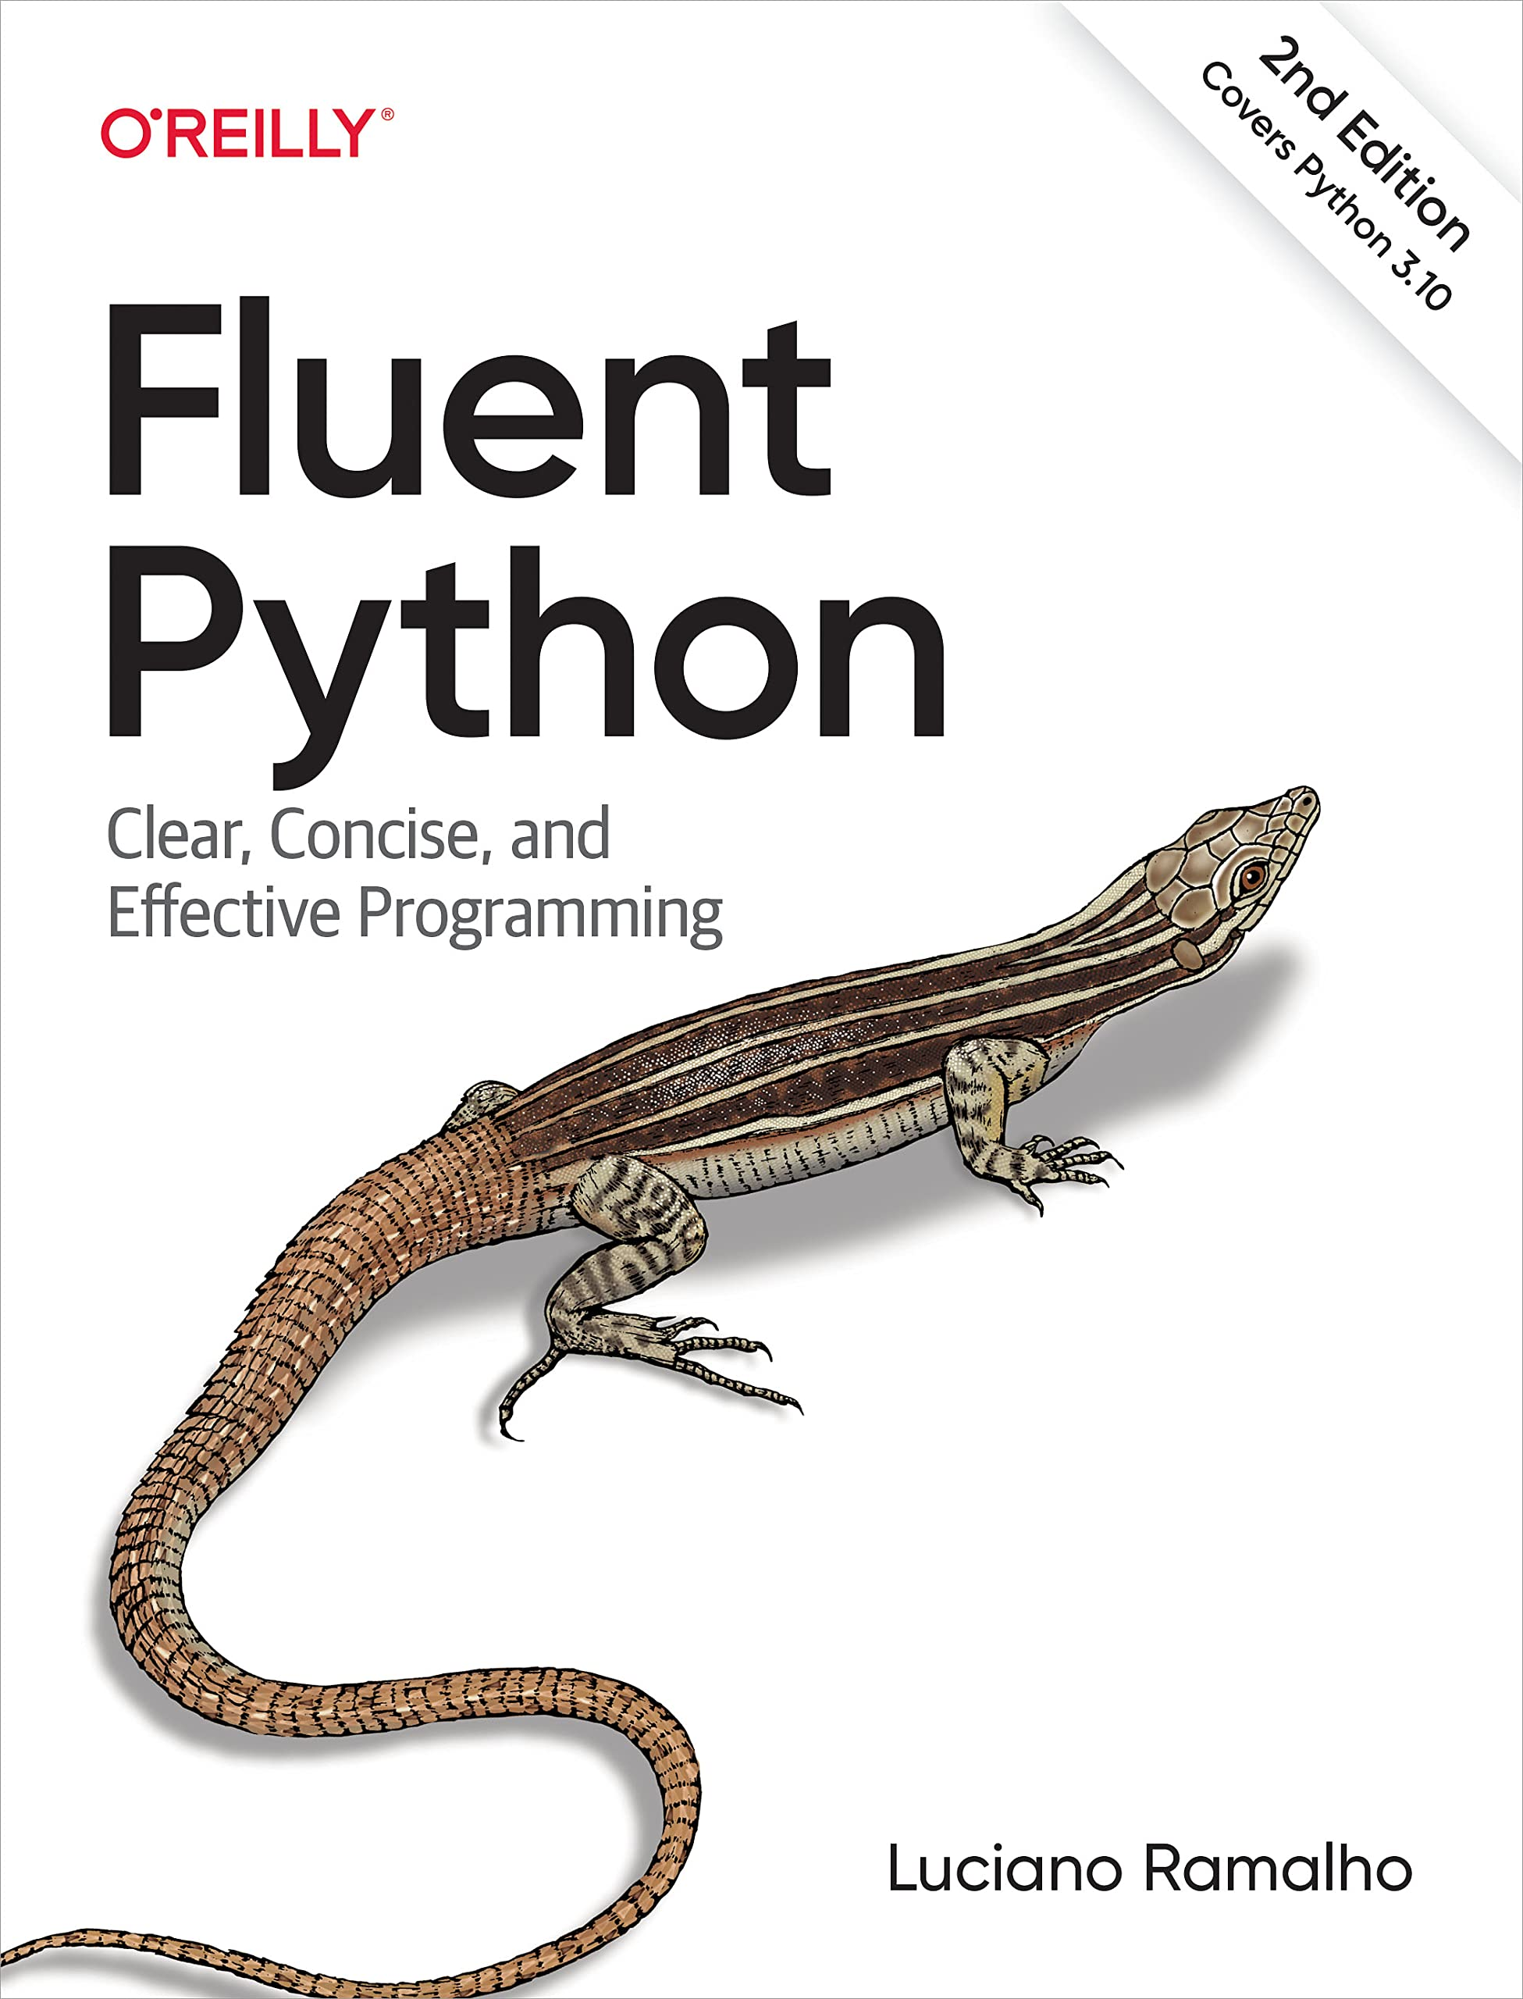
Fluent Python, Luciano Ramalho
Fluent Python

Slide 6
Fluent Python, Luciano Ramalho
A deeper understanding of Python’s data model and how it affects the behavior of objects
Techniques for creating efficient and effective data structures using built-in types and classes
Best practices for writing readable and maintainable code
Advanced knowledge of functions, classes, and metaclasses, and how they can be used to write more powerful code
Understanding of how to use decorators, context managers, and generators to write more efficient code
Knowledge of how to use concurrency and parallelism in Python to improve the performance of your code

Slide 7
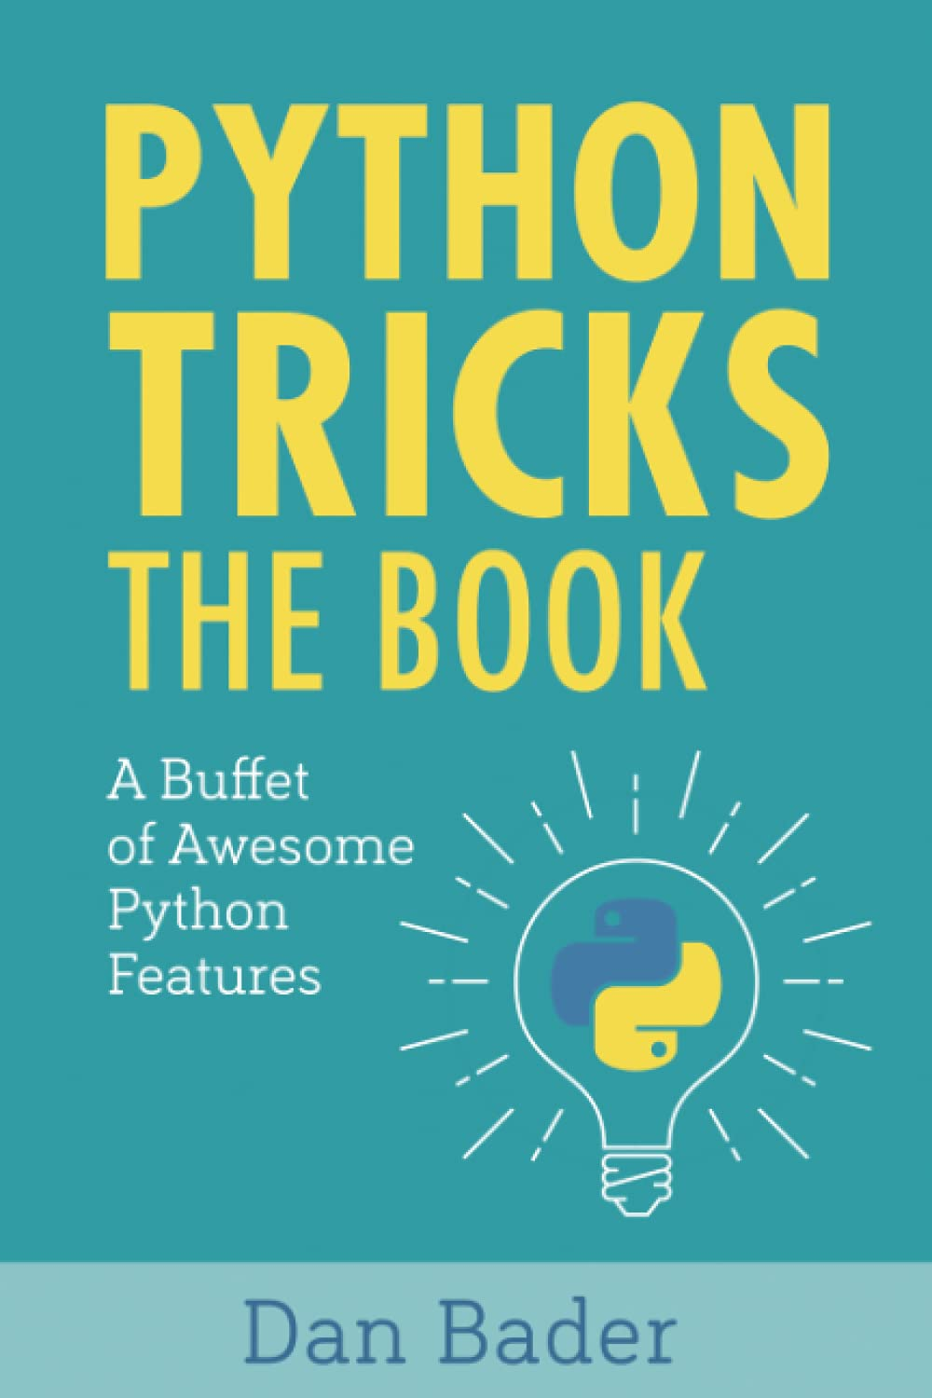
Python Tricks: A Buffet of Awesome Python Features, Dan Bader
Python Tricks

Slide 8
Python Tricks: A Buffet of Awesome Python Features, Dan Bader
Understanding of lesser-known but powerful features of the Python language
Tips and tricks to improve your coding skills
Techniques for writing more efficient and readable code
Knowledge of advanced data structures and how to use them effectively
Understanding of best practices for debugging and troubleshooting Python code
Familiarity with built-in modules and third-party libraries

Slide 9
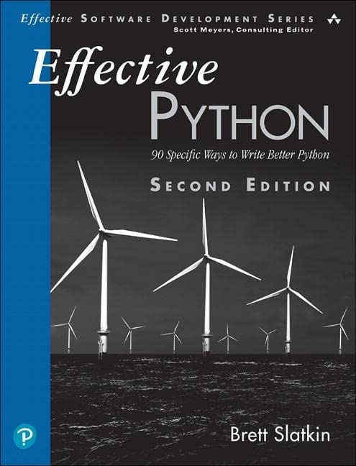
Effective Python: 59 Specific Ways to Write Better Python, Brett Slatkin
Effective Python

Slide 10
Effective Python: 59 Specific Ways to Write Better Python, Brett Slatkin
Best practices and techniques for writing better Python code
Understanding of how to write efficient, readable and maintainable code
Familiarity with Object-oriented and functional programming techniques
Knowledge of how to test, debug and maintain your Python code
Understanding of how to use decorators, context managers and generators
Best practices for working with data, text and dates
How to write concurrent and parallel code

Slide 11
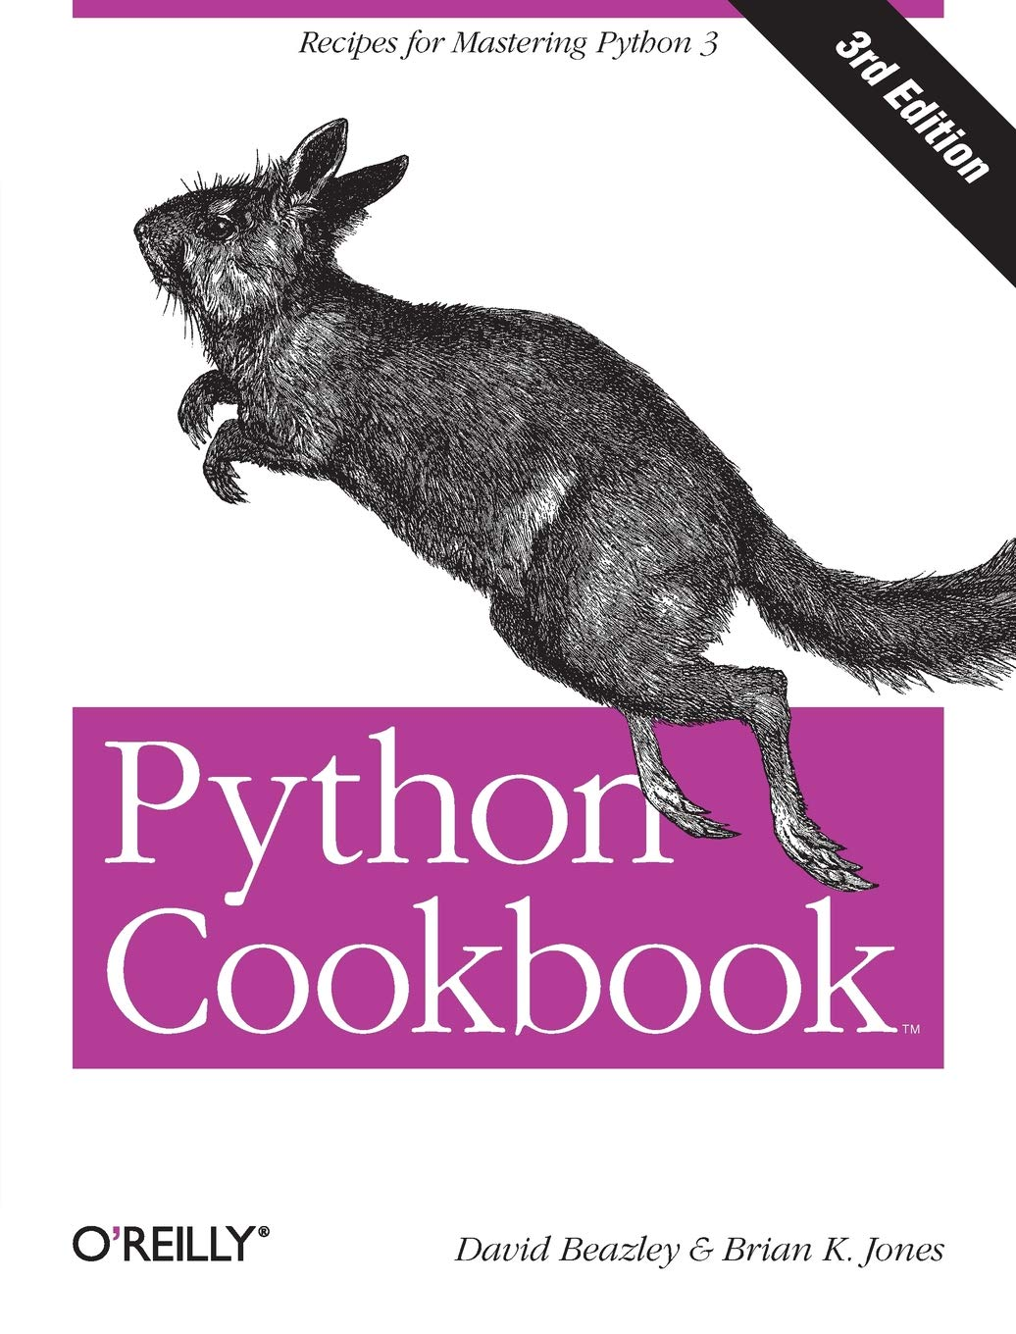
Python Cookbook, David Beazley and Brian K. Jones
Python Cookbook

Slide 12
Python Cookbook, David Beazley and Brian K. Jones
Solutions to common problems in Python programming
Techniques for working with data structures, algorithms, and data processing
Best practices for working with strings, text, and files
Understanding of object-oriented and functional programming
Techniques for working with network and web programming
Best practices for testing and debugging
Knowledge of how to use concurrency and parallelism in Python to improve the performance of your code
A collection of ready-to-use code snippets that can be easily adapted to specific use cases

