Slide 1
How a Small Team Can Develop Complex Systems
Challenges and Opportunities
Behzad Samadi

Slide 2
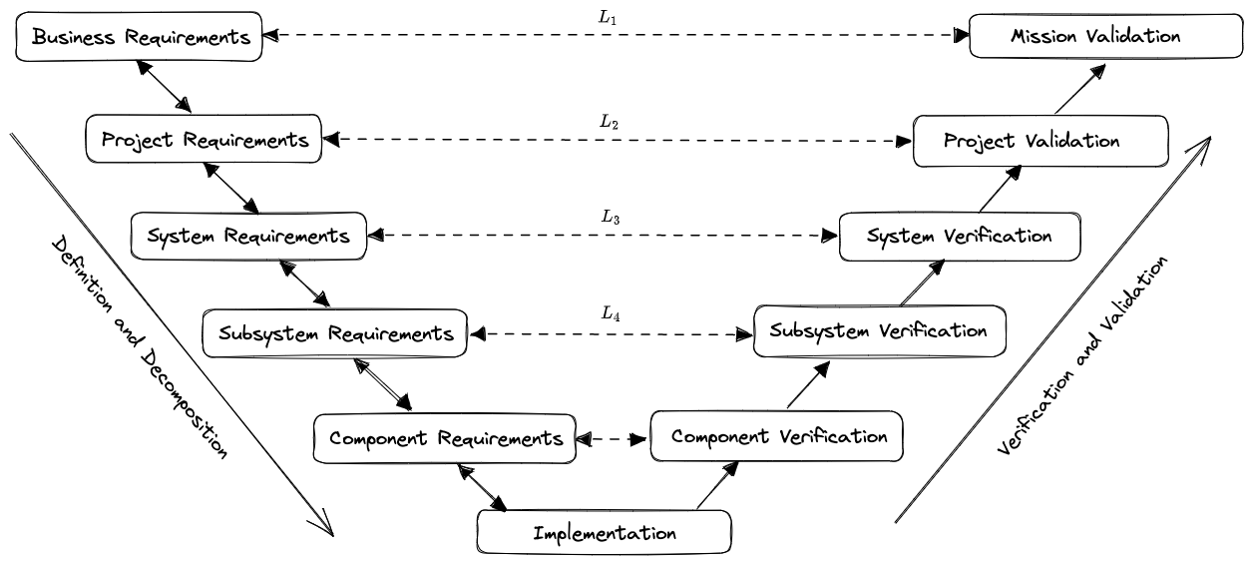
Designing a Complex System
Model Based Systems Engineering (MBSE)
The V Diagram
Notes:
Systems Engineering “V” Diagram
Using GitLab for ISO 26262-6:2018 - Product development at the software level

Slide 3
Learning MBSE
Some references to learn more about MBSE:
NASA Systems Engineering Handbook
Applying a Model-Based Approach to Support Requirements Analysis on the Thirty-Meter Telescope
Open Model Based Engineering Environment
Notes:
Model Development kits

Slide 4
Modularity
A modular system is made of smaller and simpler components (modules) that can be reused, replaced or reconfigured.
The way components interact (middleware) keeps the system together while the components are replaced or reconfigured.
Modularity helps to maintain the system’s functionality over time.
Modularity enable teams of engineers collaborate (work in parallel) on designing and implementing a complex system.

Slide 5
Modular Products
Some examples of modular design are:
Lego bricks: You can use different bricks to create different shapes and models.
IKEA furniture: You can assemble different parts to create different furniture pieces or configurations.
Desktop computers: You can customize different components to create different computer specifications or performance.

Slide 6
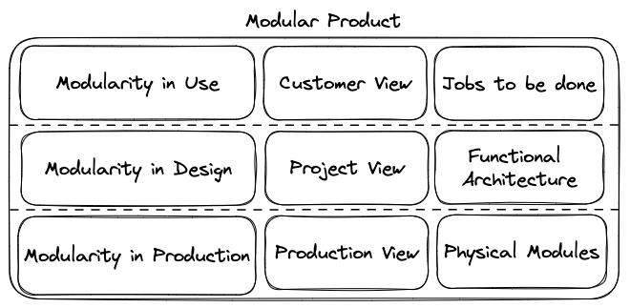
Different Types of Modularity
Types of Modularity

Slide 7
Software-Defined Products
Hardware-defined:
  Features of the product are static and cannot be changed.
  To get new features, you need to buy a new product.
Software defined:
  New features will be added to the product through over-the-air updates.
  The product can be customized for each customer using software settings.
  New business models and types of collaboration become possible.
Notes:
Software-defined vehicles

Slide 8
Open Research and Innovation
Open research (OECD definition): It is the practice of making “the primary outputs of publicly funded research results – publications and the research data – publicly accessible in a digital format with no or minimal restriction.”
Publicly available
Reuseable
Transparent

Slide 9
Open Research Challenges
May require more time and resources
May raise ethical or legal issues
May face technical or cultural barriers

Slide 10
Learning More About Open Research
One of the most comprehensive resources for learning about open research is The Turing Way handbook to reproducible, ethical and collaborative data science.
Reproducible research
Project design
Communicaiton
Ethical research
Notes:
The Turing Way on GitHub

Slide 11
Open Research Results
Open data
Open source software
Open hardware
Open access publicaitons
Open notebooks

Slide 12
Open Scholarship
According to The Turing Way hanbook, open scholarship is a concept that extends open research further. It relates to making other aspects of scientific research open to the public, for example:
Open educational resources: OpenStax and edX
Equity, diversity and inclusion
Citizen science

Slide 13
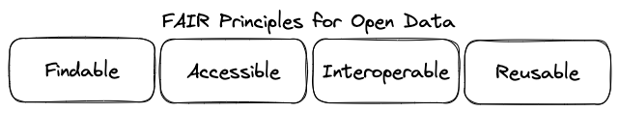
Open Data

Slide 14
Open-source Software
Open-source software is an important resource for innovation:
It allows users to customize, modify and improve their software according to their needs
It reduces costs, time and resources for software development
It prevents vendor lock-in and promotes interoperability
It fosters innovation, collaboration and learning among developers

Slide 15
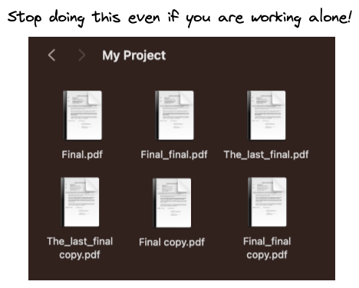
Tracking Project History

Slide 16
Version Control
Tracking how a set of files changes over time
Going back back to previous versions of any file or the whole project easily
Collaborating with others on a project without interfering with their work on the same files
Making branches to try out different changes (such as new features or bug fixes) separately from the main branch
Saving a specific version of your work as a tag or a release for later use
Notes:
Introduction to version control with Git
Version Control

Slide 17
GitHub
Git repositories: public or private
GitHub Pages: make a website with your files
GitHub Actions: automate your tasks
GitHub Projects: create plans and monitor your progress
GitHub Discussions: a forum for collaborative communication
GitHub Wiki: a knowledge base for your project

Slide 18
Software Development Challenges
Where can I find the latest version of this feature?
It used to work.
It works on my computer.
What are the requirements of the project?
What are the short term objectives and key results of the project?

Slide 19
Software Project Structure
Software binders:
Source code
Dependencies and configuration files: pyproject.toml
Continuous integration job description: build and test pipelines
Continuous deployment job description: deployment pipelines

Slide 20
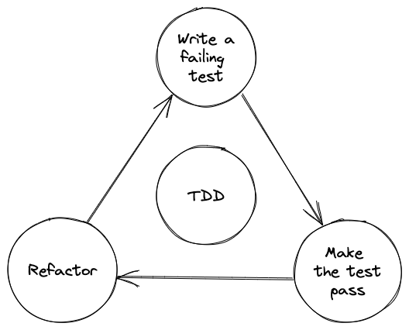
Test-Driven Development

Slide 21
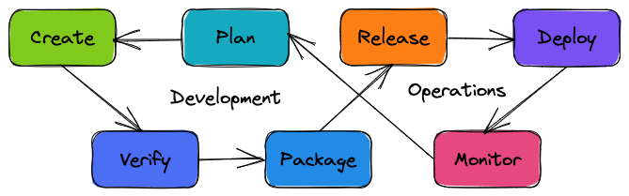
DevOps

Slide 22
GitHub is a Search Engine for Open-Source Software
Search function: in:name, in:description, in:readme
Topics: labels that help you discover projects
Explore page: curated collections of projects
External resources:
  Awesome lists: curated lists of awesome resources for various topics
  CodeTriage: helps you find open source projects that need your help
  Libraries.io: monitors over 3 million open source libraries across 37 different package managers

Slide 23
Take Action: Solve a Real-World Problem
Choose a Topic: Pick a challenge to address.
Research: Study existing solutions and requirements.
Create a Repository: Set up a project on GitHub with code and documentation.
Implement: Build a solution using best practices like modularity and TDD.
Add a Simulation (if possible): Validate your solution.
Share: Make your project open-source for collaboration.
Start Small, Think Big, Make a Difference!

