Slide 1
Planning Your Financial Future with AI
A year of spending, from your own statements
OWL Planning · presented with Collegica

Slide 2

Notes:
Welcome slide, held while people find seats. Presented by OWL Planning — Optimal Wealth and Longevity Planning — with Collegica.

Slide 3
Today
How Collegica started
Aging well
Working with AI
What to do at home
Then: a financial advisor
Notes:
About 15–20 minutes: four on the story, two or three on aging well, three on working with AI, nine or ten on the steps, and one on why a human advisor comes next; then two or three minutes of quick, practical questions. The event page has everything people need afterwards.

Slide 4
How Collegica started

Slide 5
2020: robots, from a distance
COVID. I was in Toronto, working with a robotics company in Vancouver
I was remote anyway; in Vancouver, the space was split into three sections, one person in each at a time
My work: simulation environments and teleoperation, operating robots remotely
Notes:
Tell it as it happened. Remote work was already normal for me; the office in Vancouver ran with one person per section.

Slide 6
A lab, and a university, in a browser
A simulation environment can run in a web browser: much of the science and engineering of physical systems can be learned there, with nothing to install
The universities were closed
The idea: an online university where the only thing a student needs is a computer with a browser
That is how Collegica started
Notes:
The realisation: the same simulator I used for work could be a classroom.

Slide 7
Then, and now
I never got to finish the idea; with AI coding assistants, it is much more feasible today
A few weeks ago I started updating collegica.org
Robotics, software development, AI, finance, and aging well
Notes:
One sentence on the sections: robotics in simulation, a 3D world that boots in a tab; software development; AI as tools, not magic; finance, the mechanics that quietly cost people money; and aging well, which is where the talk goes next. Apps, events and talks are on the same site.

Slide 8
Aging well

Slide 9

Three kinds of capital

Slide 10
Mind, muscle and money: all three compound, all three decay
All three are far cheaper to build early than to repair late
Notes:
From “Planning to Age Well, with AI” on the site: enough money to stop worrying about it, and still able to carry your own groceries up your own stairs.

Slide 11
Know where you stand
Measure what a year costs you.
Every financial plan starts with your current financial status
Twelve months of actual spending, not a guess: your number
Most people are wrong by 20–30% on their first guess
Notes:
This talk is about that first step only. I am not recommending a financial plan; what to do with the number is a conversation with a human advisor, which is why one is speaking after me.

Slide 12
Working with AI

Slide 13
Let your AI do the reading
I wrote collegica.org for AI agents as well as for people
You don’t have to read the article
Give it to your AI: it reads the method and does the work
You are interested in the results, and in checking them
Notes:
This is the mindset shift. The site carries a version written for agents (llms.txt, a knowledge bundle, an MCP server at mcp.collegica.org), so an AI can read the method exactly and follow it. What stays yours: knowing what to ask for, answering what only you know, and checking the result.

Slide 14
Install the desktop app
ChatGPT, Claude or Gemini: the desktop app, not the website
The desktop app can open files and folders on your computer and work on them
It is safer: it writes code that processes your statements
Your statements stay in one folder; the results come back to the same folder
Notes:
Download from the company’s own site: chatgpt.com, claude.ai, gemini.google. Sign in, and the app asks for permission before it opens a folder. Code does the arithmetic exactly, the same way every time, instead of the AI reading figures off the page; the statements stay in your folder, and the app’s settings say how what it reads is handled. Gemini’s desktop app runs on Mac and Windows; working on local folders arrived on the Mac first (Apple Silicon, macOS Sequoia or later) and is still rolling out on Windows. Beyond this budget: the same habit works for any folder of documents.

Slide 15
What to do at home

Slide 16
Why a statement is not a budget
Movement | Why it is not spending
Transfer between your accounts | The card payment is not spending; the card purchases already are
Lending and its repayment | An asset you hold; repaid, it is not income
Savings | Moving money into an RRSP or TFSA does not consume it
Pass-through | Arrives and is forwarded the same day
Income | An employer’s e-transfer looks like any other
Spending | What is left. This is the number
Notes:
A statement records every dollar that left an account, and only some of it was spent. Your desktop AI will do the sorting, following the article; this table is what you check its work against.

Slide 17
Step 1 — One folder of exports
Export from online banking for every account you spend from: chequing, each credit card, any line of credit
The cards, not just chequing: chequing alone shows card payments and nothing about where the money went
Six months if you have them; one month works
Nothing else in the folder
Notes:
Filenames do not matter. PDF works; CSV is more reliable where the bank offers it.

Slide 18
Step 2 — The folder and the prompt
Open your desktop AI app and start a new conversation
Let it open your folder (the app asks for permission)
Paste the prompt from the event page:
collegica.org/events/monthly-budget
Send it
Notes:
The prompt tells the AI to read the whole article and follow it: load every file, sort every line into the six kinds, take the median of complete months, hold out large one-time payments, ask instead of guessing, label every figure measured or stated, and save your answers for next time. The permission step looks different in each app and version.

Slide 19
Step 3 — Check what it found
It lists the files, the accounts, the date range and any problems, then waits.
Is every account there, including every card?
Do the dates cover the months you expect?
Then tell it: go
Notes:
This is the cheapest place to catch a missing card export. A missing account gives a confident wrong answer, not a partial one.

Slide 20
Step 4 — Answer its questions
Largest amounts first. The kind of thing only you know:
Was that cheque or e-transfer a loan? Has any come back?
Was that large payment one-time, yearly, or the start of a monthly one?
What do you pay yearly that these months don’t show: insurance, property tax, a trip?
Each answer is saved in budget-output/rules.md, with your reason.
Notes:
This is where the number stops being the AI’s and becomes yours.

Slide 21
Step 5 — Read the result, and check it
Planning figure = recurring spending (measured) + your stated yearly items
Spread: 90%–109% of the median is a number to plan on; 57%–134% is a question
Card payments, savings and loans are not in spending; card purchases are
Looks wrong? Ask it to show the ten biggest lines
Notes:
The result is written to budget-output/budget.md: recurring, held-out one-offs and undecided items, and what was set aside as transfers, savings, lending and pass-throughs. Two runs of the same prompt can differ by a few percent; 20% off usually means a missing account or a double-counted card.

Slide 22
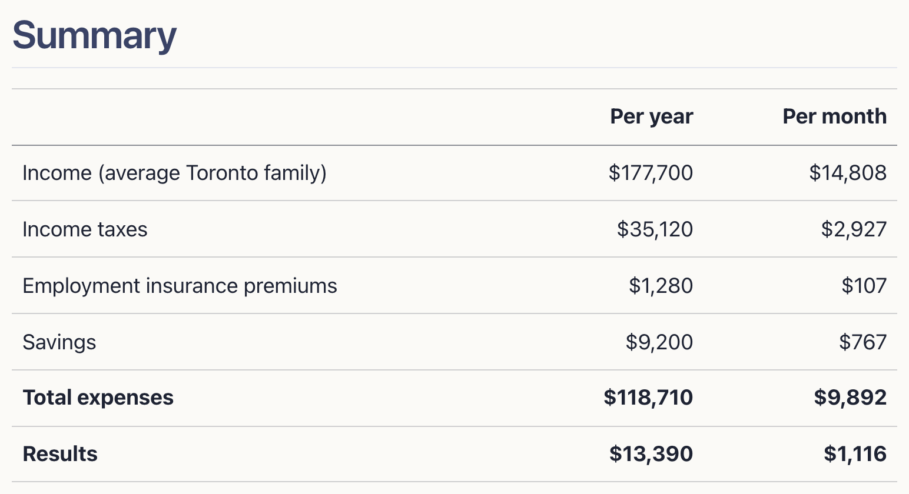
What you get

Slide 23
An illustrative Toronto family of four, in an advisor’s form: collegica.org/events/monthly-budget/example
Notes:
Not a real family: Statistics Canada averages for a couple with children, adjusted to Ontario, with average Toronto family income. The full page has every line of the form (housing, utilities, transportation, food, recreation and education, health care, debt, personal) and its sources. Your own output is the same shape, with your own figures.

Slide 24
Your planning figure
Write down your number, and whether each part is measured or stated
Keep the budget-output folder; next quarter, new exports and the same prompt
Then take it to a human advisor: it is where the conversation starts

Slide 25
AI does not replace people
AI can tell you where you stand; what to do next is a human conversation
We still need to talk to a human advisor, and it is better to
That is what I did, and I am very happy about it
Even after many successful investments, when I thought I knew everything
Notes:
Say this in your own words; it is the bridge to the advisor who speaks next. Bringing a measured figure to that first meeting makes it a better one.

Slide 26
Quick questions
The prompt and the practice statements: collegica.org/events/monthly-budget
The method: A Year of Spending, from Your Own Statements
The in-browser tool: collegica.org/owl
Notes:
Two or three minutes, practical questions only: exporting from a bank, which app, PDF or CSV, the folder. Anything about someone’s own money, or what to do with their number: “please save that for the end, for our advisor.” Announcements go out through the Mechatronics3D newsletter.

